Slide 1
Lecture 13
RPM and its advantages

Slide 2
Course Content
The RPM and its advantages
The RPM Package Management Tool
RPM console commands
RPM security features
A few examples of RPM package installation

Slide 3
What Is RPM?
The RPM package manager is an open source packaging system distributed under the GNU GPL.
It runs on most Linux distributions and makes it easy for you to install, uninstall, and upgrade the software on your machine.
RPM files can be easily recognized by their .rpm file extension and the 'package' icon that appears in your navigation window:

Slide 4
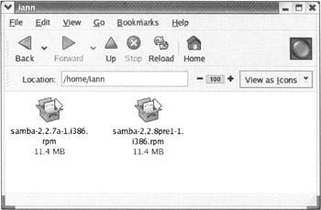
What Is RPM?

Slide 5
The benefits of using RPM can be summarized as follows:
Simplicity:
  RPM simplifies the task of installing software. RPM packages can be managed using the RPM GUI interface, or via the command line.
Upgradeability:
  RPM gives us the flexibility to upgrade existing packages without having to reinstall them.
  You can freshen and upgrade parts, or all, of your system automatically, with the minimum of fuss.

Slide 6
The benefits of using RPM can be summarized as follows:
Manageability:
  RPM makes it easy to manage software packages.
  It maintains a database of all the packages installed on the system, so you know exactly what you've got installed, what version it is,and when it was added.
Package queries:
  RPM provides options to query packages for more details in different ways.
  You can search the package installed on the system. You can also find out what package a file belongs to.

Slide 7
The benefits of using RPM can be summarized as follows:
Uninstalling:
  RPM makes it easy to uninstall packages.
  This helps us to keep the system clean.
System verification:
  RPM also provides a feature to verify packages.
  In case of any doubt about file deletion, packages can be verified against the original package information using RPM.
  This checks all the files on the system with the package information and verifies that the files on the system are the same as those installed from the package originally

Slide 8
The benefits of using RPM can be summarized as follows:
Security:
  RPM provides commands for the user to check the integrity of packages.
  Packages can be checked using md5sum to verify that they have not been corrupted or tampered with since they were created.
  RPM also provides functionality to verify a package provider's identity and package integrity using gnupg (very handy if you're downloading sensitive material from the Internet, as you want to be sure that you're installing what you think you're installing).

Slide 9
The RPM Package Management (GUI) Tool
  New features is the Package Management Tool.
  This tool is a graphical user interface (GUI) designed for the management of package installation and removal.

Slide 10
Starting the RPM Package Management Tool
  There are two ways to start RPM.
  To do it from the Main Menu, select Main Menu | System Settings |Add/Remove Applications.
  Alternatively, from the command line you can type the following command
    $ redhat−config−packages
you'll be prompted to enter the root password.

Slide 11
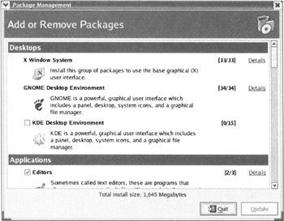

Slide 12
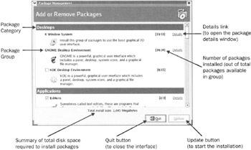
Package Management Tool Functions

Slide 13
Package Category Package Groups
  Desktops X Window System
GNOME or KDE Desktop Environment
  Applications Editors
  Engineering and Scientific
Graphical Internet
Text−based Internet
  Office/Productivity
Sound and Video
Authoring and Publishing

Slide 14
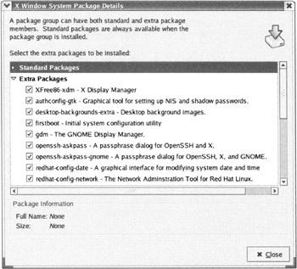
You can view the details of any group of packages by clicking on the Details link.

Slide 15
Adding and Removing Packages
The package management tool makes adding and removing packages very simple.
In fact, it's just as easy as using the Add/Remove Programs menu under Microsoft Windows.

Slide 16
Installing Packages
When we select any group using the RPM package management tool interface, it automatically selects the standard packages
Dependent packages are packages needed in order for the main package to run properly.
We can customize the packages to be installed by clicking on the Details button.
Once you've made your selections, click on the Update button on the main window.
The package management tool will then calculate the disk space required for installing packages

Slide 17
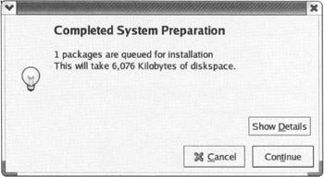

Slide 18
Removing Packages
To remove all the packages installed within a package group, uncheck the checkbox beside the package group.
To remove individual packages, click the Details button beside the package group and then uncheck the individual packages.
Now click the Update button in the main window.
The package management tool will take care of finding and removing any dependent packages that might also be installed, just as it did in the install routine.

Slide 19
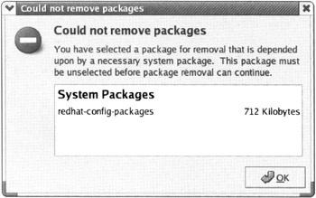
However, if the package you're trying to remove is required by
other installed packages, removal will stop, and you'll be shown the following warning:

Slide 20
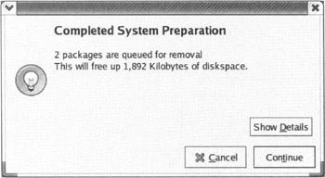

Slide 21

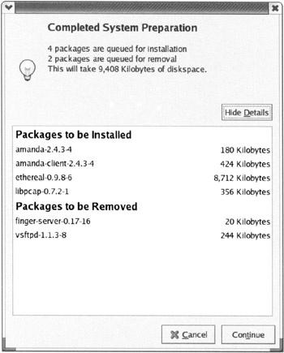
Combined installation and removal

Slide 22
Package Installation and Configuration Files
If you're installing a new version of older software, or upgrading your existing version, there's a small chance that the installation will encounter pre existing configuration files.
The RPM Command Line Tool
  If you're installing a package, a new configuration file with an .rpmnew extension is created.
  The old file is left in place, and you'll need to swap them manually if you want to take advantage of the new files settings

Slide 23
Package Installation and Configuration Files
If you're upgrading a package, the old configuration file will be renamed with an .rpmsave extension, the new file will take its place.
If you're removing a package, and the tool detects that a configuration file has been modified
leave a version of the file behind with an .rpmsave extension − so it's still available if you should need it.

